Slide 1
Java Language Constructs

Slide 2
Data types
Java supports two categories of datatypes.
Primitive types
Reference Types

Slide 3
Ranges of Primitive data types
Type | Size in Bytes | Min Range | Max Range
byte | 1 | -2⁷ | 2⁷-1
short | 2 | -2¹⁵ | 2¹⁵-1
int | 4 | -2³¹ | 2³¹-1
long | 8 | -2⁶³ | 2⁶³-1
char | 2 | 0 | 2¹⁶-1
float | 4
double | 8
boolean | JVM Specific (typically 1)
3
Notes:
Note that char is 16 bit Unicode character. Also, there no unsigned char in java.

Slide 4


Unicode Character
UNICODE is a 16 bit character.
They are generally represented in hexadecimal format.
‘\u’ in beginning of the character is used to represent hexadecimal character.
The characters represented include all basic English letters, numbers, special characters and characters from other languages also !
‘A’ → ‘\u0041’
You could write the entire java code as
\u0069\u006e\u0074 \u0061;
This above code represents
int a;
What is Unicode for F?
4
Notes:
Why Unicode? Unicode is used to overcome the limitation of ASCII/Extended ASCII as ASCII has limited number of bits therefore does not have capability to represent multi-lingual characters. Unicode has 16 bits and therefore, has ability to represent multi-lingual characters. It has become an industry standard and is used for Internationalization. Unicode transformation format is character encoding form that assigns each Unicode scalar value to a unique code unit sequence. The Unicode Standard defines three Unicode encoding forms: UTF 8, UTF 16,UTF 32 . Java 6 char supports UTF 16.

Slide 5
Identifier
An Identifier must begin with
a letter (A-Z, a-z, or any other language letters supported by UFT 16)
An underscore (_)
A dollar ($)
after which it can be sequence of letters/digits.
Digits: 0-9 or any Unicode that represents digit.
Length of the variable name is unlimited
Java reserved words should not be used as variable names.
5

Slide 6
Variable Naming Convention
Must begin with lower case
Must always begin your variable names with a letter, not "$" or "_".
Avoid abbreviations, use meaningful names.
If a variable consists of two or more words, then the second and subsequent words should start with upper case.
For example, rowHeight.
6
Notes:
http://download.oracle.com/javase/tutorial/java/nutsandbolts/variables.html

Slide 7
Some examples of valid identifiers are:
AvgTemp
count
a4
$test
this_is_ok
Invalid variable names include:
2count
high temp
Not/ok

Slide 8
Literals
A constant value in Java is created by using a literal representation of it. For example,
here are some literals:
100 -- integer
98.6 --- real number
'X‘ --- character
"This is a test” --- String
true and false --- boolean

Slide 9
abstract const finally int public this boolean continue float interface return
throw break default for long short
throws byte do goto native static transient
case double If new strictfp try catch else
implements package super void char extends import private switch volatile class final instanceof protected synchronized while
The keywords const and goto are reserved but not used.

Slide 10
Reading input from console
To read input from the console, JDK provides a friendly class called java.util.Scanner.
import java.util.Scanner;
class A{
public static void main(String[] args) {
Scanner sc = new Scanner(System.in);
int i = sc.nextInt();
System.out.println(i);
}
}
→Step 1
→Step 2
→Step 3
To read any primitive types, replace XXX in nextXXX() with the primitive type.
To read a string use next()
10
Notes:
Like System.out.print, Java provides System.in.read. But, it returns int. That is, it reads byte by byte. Since it is difficult for us to work with this, Java provides another friendly class called Scanner class. The full name for this class is java.util.Scanner.
The functions like java.util.Scanner.nextInt(), java.util.Scanner.nextByte(), java.util.Scanner.nextDouble(), java.util.Scanner.nextFloat(), java.util.Scanner.nextBoolean() is used to read respective datatypes.
The import statement above helps in reducing the typing effort of using full name of the class.
Reading using Scanner class involves 3 steps:
Step 1 (optional): include an import statement, so that we don’t have to type the full name of Scanner every time.
Step 2: Create a Scanner object
Step3: call functions to read() data from console.

Slide 11
Operators
• An operator performs a function on one, two, or three operands.
• Operators are divided into the following categories:
– Arithmetic operators: +, -, *, /, %
– Relational and conditional operators: <, >, <=, >=, !=, ==
– Shift and bitwise operators: <<, >>, >>>, &, |, ^, ~
– Increment and decrement operators: ++, --
– Assignment operators: =, +=, -=, *= (shortcut assignment operators)
– Logical operators: &&, ||, !
– Other operators: ?:
- new, instanceof

Slide 12
Arithmetic Operators
Unary: + - ++ --
Examples: –5, +5
char ch=‘X’;
ch++; // (ch = ‘Y’)
Binary : + - * / %
Examples: int i= j+5;
int i=-10;
int k=i++;
What will the value of k be?
System.out.println(.4%.2);
What will the code print?
12
Notes:
Example 1:
int k=10;
k++; //value becomes 11
char ch=‘X’;
ch++; // (ch = ‘Y’)
Example 2:
int a = 5;
int b = 2;
int c = a + b;
System.out.println(5%2); // output is 1

Slide 13
Relational Operators
< > >= <= == !=
Returns true or false
Example:
int i=10;
int j=20;
System.out.println( i>j );
// output is false
System.out.println(i==10);
// output is true
13

Slide 14
Exercise
Write a program to do the following,
Get two numbers as input from the user through console/cmd line and swap the values of two numbers without using a temporary variable and display the same. (15 Mins)
Determine whether the given year is leap year or not (Read the input through console ). (15 Mins)
14

Slide 15
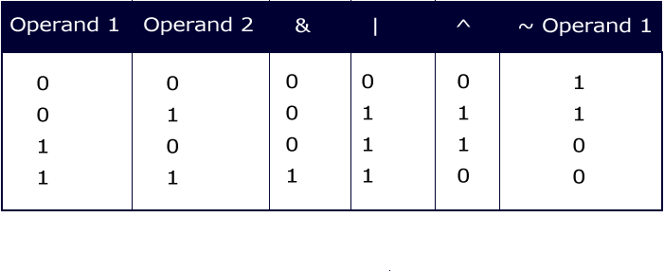
Integer Bitwise Operators
~ & | ^
They convert the integral data types into their binary form and then perform operations according the table.
15

Slide 16

Example : Integer Bitwise Operators
public class AndOrNotEx{
public static void main(String str[]){
byte x=1;
byte y=3;
System.out.println(x&y); // prints 1
System.out.println(x|y); // prints 3
System.out.println(x^y); // prints 2
System.out.println(~x); // prints -2
}}
Can you arrive at all of these without executing the code?
What will happen if you change byte to double?
16

Slide 17
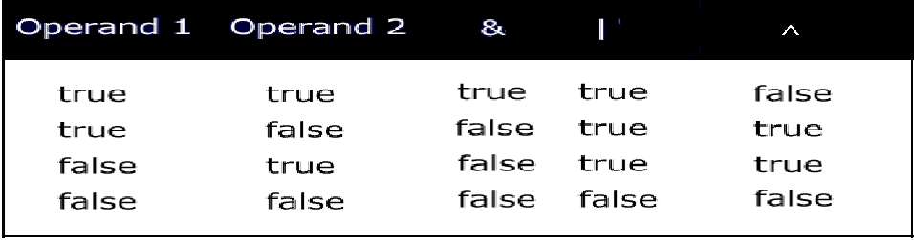
Logical Operators
& | ^
What will happen when you compile the following statement?
if(~(1>2))
System.out.println(“OK");
17

Slide 18
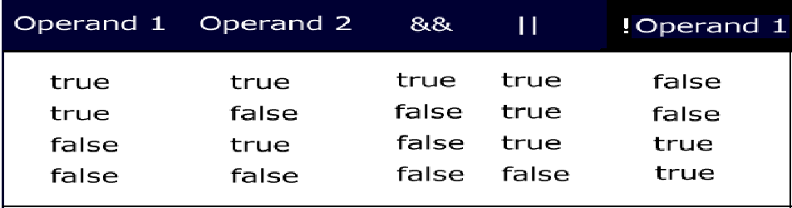
Conditional Logical Operators
&& || ! ?:
Logical operators are binary operators that require boolean values as operands.
&& and || are also called short circuit operators because they are optimized.
18
Notes:
How are the short circuit operators “optimized”?
&& checks if the first condition is false. If it is so, then it doesn't evaluate the second condition.
|| checks if the first condition is true. If it is so, then it doesn't evaluate the second condition.

Slide 19
Activity
Type this code and find out the difference between && and & operators?
public class Example{
public static void main(String args[]){
int i=0;
int j=2;
boolean b= (i>j) && (j++>i);
System.out.println(j);
b= (i>j) & (j++>i);
System.out.println(j + “ “+b);
}
}
19

Slide 20
Ternary operator
Syntax of ?:
<variable> = (boolean expression) ? <value to assign if true> : <value to assign if false>
Example :-
int i=10;
double j=10.1;
int k=(i>j)?10:20;
System.out.println(k); // outputs 20
What is the problem with the code below assuming i, j and k are declared as in the example above?
int k=(j=i)?10:20;
20

Slide 21
Compound Operators
+= -= *= /= %= &= |= ^=
Example:
int a = 10;
int b=2;
a+=b; // means a=(int)(a+b);
double d=45.3;
d/=1.2;
21
Notes:
Note that a=a+b; and a+=b; are not exact equivalents. The later involves a cast operator. We will look into this in greater detail after we have looked at cast.

Slide 22
Shift operators
>> the SHIFT RIGHT operator (Arithmetic Shift)
<< the SHIFT LEFT operator
>>> the UNSIGNED SHIFT RIGHT operator (Logical Shift)
System.out.println(2<<1); // prints 4
System.out.println(-1>>2); // prints -1
System.out.println(-1>>>2); // prints 1073741823
22
Notes:
In case of right shift there is always a debate whether the left bits that get vacant during the shift must retain the sign of the original number or not.Some people believe that the sign must be retained → Arithmetic Shift. Others believe it must not be retained → Logical Shift
That is the reason why Java came up with two shift operators >> for Arithmetic Shift and >>> for Logical Shift. (Recall the non-portability feature of Java)

Slide 23
Activity
Find out what happens if you try to shift more than the number of bits in an int ?
System.out.println(2<<32);
System.out.println(2>>32);
System.out.println(2>>>32);
System.out.println(2<<33);
System.out.println(2>>33);
System.out.println(2>>>33);
23

Slide 24
Precedence
Operators Associativity
-------------------------------------------------------
[] . () methodCall() left to right
! ~ ++ -- - + new (cast) right to left
* / % left to right
+ - left to right
>> >>> << left to right
< > <= >= instanceof left to right
== != left to right
& left to right
^ left to right
| left to right
&& left to right
|| left to right
?: left to right
= += -= *= /= >>= <<= >>>= &= ^= |= left to right
24

Slide 25
Conversions
Widening Conversions (achieved by automatic or implicit conversion)
long l=10
float f=100;
Narrowing Conversions (achieved by casting or explicit conversion)
float f=100f;
float z=10/(float)2;
All primitives are convertible to each other except for boolean.
25

Slide 26
Automatic or implicit conversion
The conversion in the direction indicated happens automatically.
byte→short→int→long→float→double
char
When an arithmetic operation happens between different numeric types, the result of the operation is always of the higher numeric data type.
When the integer literals are within the range of the specified integer data types, the conversion automatically happens. In case the literal is beyond range, the compiler flags an error.
If an arithmetic operation happens between any integer type except long, the result is an int.
Similarly when arithmetic operation happens between floating points, the result is double.
Compound assignment operator and pre/post increment/ decrement operator does the conversions required.
26

Slide 27
Loss of information
There could be loss of some information during conversion of the following:
int → float
long→float
long→ double
Example
int i=76543210;
float f= i; → 7.6543208E7
27

Slide 28
Assignment conversions- integers
int i=10;
int b=10;
int k=i+b; // ok
2. byte b1=20; // ok
short s=10; // ok
But byte b=39078; // error
3. int b=10;
byte b1=b; //error
But final int b=10;
byte b1=b; //ok
28
Notes:
Since adding 2 bytes or two integers of any type except long results in int, the value can be stored only in int or long. Java does not allow ints to be automatically truncated into lower integral types like byte or short. If we desire such conversion we must explicitly request for it through cast.

Slide 29
byte b1=20, b2=30;
int i=b1+b2; // ok
But byte b=b1+b2; // error
Same is the case with short
byte b=b+1; // error
But byte b+=1; // ok
byte c=10; // ok
byte c1=-c; // error
byte c2=c1+1; // Error : possible loss of precision
But byte c2=++c1; // ok

Slide 30
Assignment conversions- double
int f = 32;
float t=f; //ok
int k=t; //error
float f = 32.3; is compilation error, Why?
How can you correct this?
float d=3.4f;
Will the following code compile?
double f= d++;
30
Notes:
Adding float results in double and so, only double variable can be used to store the result.

Slide 31
char conversions
char c=‘A’;
int i=c;
Assigns unicode value of A to int
2. char c=65;// ok
65 is within the range of char
char c=-65; // error
4. int ii=65;
char c=ii; //error
5. char c=‘A’;
short s=c ; // error
What change can you make in int’s declaration so that the code compiles?
Note that even though short and char are 16 bits, an error is generated. Why should compiler not allow this?

Slide 32
Explicit conversion or casting
Any conversion between primitives (excluding boolean) that is not possible implicitly can be done explicitly.
Conversions like (a) double to long, (b) char to byte etc.
This is done through what is called casting.
Example:
int k=10;
char b=k; // error
Casting makes the error disappear:
char b=(char)k;
byte b=(byte)128;
What will be the value when you print b? Compute and arrive at this by yourself.
32
Notes:
128 is 10000000. Since 8th bit for a byte represents a –ve number, 10000000 is –ve.
To get the value of – ve number find its 2’s complement (1’s complement+1)
1’s complement of 128 is 01111111
+1 is 10000000 which is 128.
Since the number is a –ve number the result is -128.

Slide 33
Flow control statements
Conditional Statements
if statement
switch statement
Loops
for statement
enhanced for statement
while statement
do-while statement
Loops can have break or continue.
All of these statements except (enhanced for statement) are same as that in C (in terms of the syntax and way they work).
But note that for Java conditions must always evaluate to boolean value.
The switch expression should be integer value (not long) or char and case expression must evaluate to a constant/final value
Coming up later
33
Notes:
if statement syntax:
if (condition) statement(s)
[else statement(s)] ;
if statement is same as that in C except that the condition must always evaluate to a boolean value.
Examples:
if(x==y) x++;
if (x>y) y++;
else x++;
if(true) { y++;
System.out.println(“OK”);
}
Switch statement:
Syntax:
switch (expression){
[case expression: statement(s)]
…
[default: statement(s)]
}
switch statement is also very similar to the one in C
switch expression must be either integer value (not long) or char. In Java SE and later, String can also be used in switch statement's expression
case expression must evaluate to a constant/final value.
break statement after every set of case statements will prevent fall-through.
for loop:
Syntax
for(initialization;condition;iteration) statement(s);
for statement (like in C) is used to iterate through a set of statements over a range of values specified and computed by the for loop itself.
The initialization expression is
used to initialize variable(s)
more than one variable initialization is separated by commas)
can also include initialization with declaration
executed only once when the loop begins.
The condition expression
Must evaluate to a boolean value
Loop iterates till the condition is true
Only one condition can be specified; multiple conditions can be combined using logical operators
is evaluated at the beginning of each loop
The iteration expression
is usually an increment or decrement expression of the variable initialized in the initialization expression
is evaluated at the beginning of each loop
while and do-while:
while(condition) statement(s);
do statement(s) while(condition);
Like in C, while and do-while statement are used to iterate through a set of statements till the condition remains true.
while evaluates the condition before at the beginning of each iteration whereas do-while evaluates condition only at the end of each iteration.
Therefore, do-while guarantees that the loop statements are executed at least once.
Condition expression must result in ___________
Can you think of a situation where you would prefer do-while instead of while?

Slide 34
Common Errors
Can you figure out why the following statements are erroneous?
if(1) System.out.println(“OK”);
while(1.1) {// some statements;
}
switch(myString){
case “Sun” :
case “Sat”: System.out.println(“Holiday”);
break;
default: System.out.println(“Holiday”);
}
for(int i=1;(i<5); i++) {System.out.println(i+j);}
i=12;
34

Slide 35
for loop omitting options
int j=10;
for(; j>0 ;j--) {
System.out.println(j);}
int j=10;
for(;j>0;) {j--; System.out.println(j);}
int j=10;
for(;;j--) {
if(j<0) break;
System.out.println(j);}
for(;;){…}
What is the purpose of the statement above?

Slide 36
Exercise
Tax slabs for general
0 to 1,80,000 No tax
1,80,001 to 5,00,000 10%
5,00,001 to 8,00,000 20%
Above 8,00,000 30%
Income tax slabs 2011-2012 for Women
0 to 1,90,000 No tax
1,90,001 to 5,00,000 10%
5,00,001 to 8,00,000 20%
Above 8,00,000 30%
Write if statements to achieve this.
Make sure that you indent the code well so that it is readable.
(20 mins)

Slide 37
Exercise
A shopkeeper sells three products whose retail prices are as follows:
Write an application that reads a series of pairs of numbers as follows:
a) Product number or code (Code is not case sensitive)
b) Quantity sold
The application should use a switch statement to determine the retail price for each product. It should calculate and display the total retail value of all products sold. (20 Mins)
Product No | Product Code | Retail Price
1 | A | 22.50
2 | B | 44.50
3 | C | 9.98
37

Slide 38
Exercise
Consider user has N eggs. Then display the no of eggs in gross (144 eggs
make one gross) and no of eggs in dozen (12 eggs make one dozen) and
the no of eggs that is left out remaining. The total no of eggs can be got as
input through console. The program should display how many gross,
how many dozen, and how many left over eggs the user has. (20 Mins)
For example, if the input is 1342 eggs, then the program should respond
with
Your number of eggs is 9 gross, 3 dozen, and 10
(20 mins)

Slide 39
Activity: do-while loop
public class Test1 {
public static void main(String[] args) {
// TODO Auto-generated method stub
int f1=0,f2=1;
System.out.println(f1);
System.out.println(f2);
do {
f2=f1+f2;
System.out.println(f2);
}while(f2<10);}
}
What is the program trying to do?
There is a problem with this code. Can you correct this code by just inserting a line?
What will the code display after correction?
39
Notes:
f1=f2;

Slide 40
Activity
Select the statement (s) ideal for the scenarios.
Scenarios
Statements
User has to enter his/her information. After he/she finishes entering information, a prompt (Y/N) whether he/she wants to change some e details is displayed. If Y is entered he/she can re-enter the details again.
Sum of first 50 odd numbers
Easiest way to write infinite loop.
Any of the 5 different types of Graph is to be displayed based on the user’s choice.
if statement
switch statement
while statement
do-while statement
for statement
40

Slide 41
Labeled continue/break statements
The normal break (without labels) is used to break out of the loop (used in switch statement also) and continue is used to skip the rest of the statements in the loop and start with a new iteration.
In cases where there are multiple loops, when we break out or continue the loop, the immediate loop breaks or continues.
break and continue statement can also be used with labels to indicate from which outer loops should it break out or continue.
The outer loop where the break or continue must happen is labeled.
Note that labeled break/ continue will work only if the labels are provided for the loops in which they are enclosed.
41

Slide 42
Labeled continue/break statements
Example:
first: for(int i=0;i<2;i++)
for(int j=1;j>0;j--)
if(i!=j)
continue first;
else
System.out.println(i+j);
//prints 2
When i=0 and j=1
42

Slide 43
Exercise
Write a program to display whether the given number is palindrome
or not. Also, check whether the number is a prime number. If it is a
prime number, display the number along with the alphabet
‘p’ appended to it.
(30 Mins)
Eg: 1221
Op: It is a palindrome
It is not a Prime number
Eg : 11
It is a palindrome ,it is a prime number , 11p
43

Slide 44
Arrays
Arrays are fixed-length structures used for storing multiple values of the same type.
Array items can be of either a simple primitive data type or composite data type(objects).
Arrays can be multidimensional.
Example:
int[] numbers;
long grid[][];
char alphabet[] = new char[26];
int primes[]={1,2,3,5,7};

Slide 45
int a[3]; // error
int a[]; // creates an array reference
a=new int[3];
//allocates an array and initializes the values to 0

Slide 46
int a[]=new int[4];
a=new int[5]; // valid

Slide 47
Printing an array
Int a[]={4,5,6,7,9};
for(int i=0;i<a.length;i++)
System.out.print(a[i]);
for(int n:a)
System.out.println(n)

Slide 48
Test your knowledge
What is the output of the code:
for(int x=1;x<10;x++)
System.out.println(x);
System.out.println(i);
// compilation error

Slide 49
int x=12,y=x;
switch(x)
{
case 10: break;
case y: System.out.print(“hello”);
default: System.out.print(“end”);
}
//compilation fails

Slide 50
int x=12;
int final y=12;
switch(x)
{
case 10: break;
case y: System.out.print(“hello”);
default: System.out.print(“end”);
}
Ans:
hello
end

Slide 51
int i=0;
for(i=1;i<10;i++);
System.out.println(i);
//10

